Slide 1
Principles of Database Systems (CS307)
程然
(Original Slides by 马昱欣 老师)
Department of Computer Science and Engineering
Southern University of Science and Technology

Slide 2
Instructor
Dr. Ran Cheng 程然 (Associate Professor in CSE)
Office: Room 316, South Tower, Engineering Building
Personal Website: https://chengran.tech/
Group Website: https://emi.sustech.edu.cn/

Slide 3

Lecture Notes, Sakai and QQ Group
Slides and lab sheets will be on the Sakai site.
QQ Group
ID: 949474976
Teaching assistants will be there to help you

Slide 4
Textbooks
Reference book:
A. Silberschatz, H. Korth, and S. Sudarshan. Database System Concepts. McGraw-Hill, New York, 7th Edition, (2019).

Slide 5
Grading Policy
Lecture and Lab Attendance (10%)
Assignments 24%)
4 Assignments (including 1 in-class quiz)
Project (36%)
2 Projects
Final exam (30%)

Slide 6
Grading Policy
Late Submission
We do not accept late submissions. All assigments, quizzes, and projects, etc. will receive a score of zero if you miss the deadline.
Groups for Projects
Groups across different lab sessions are not allowed
Please try to find your teammate in the same lab session
Grades
The teachers and TAs guarantee that your assignments and projects will be evaluated carefully and unbiasedly
We do not accept argueing with teachers over a certain grade once the decision has been made

Slide 7
Plagiarism
Zero tolerance!

Slide 8
Some Other Stuff
Computing technologies advance very fast
Search online to learn more by yourself
Search engines (Google, Bing, Baidu, etc.), StackOverflow, GitHub.
The lecture notes can guide your self study
You are encouraged to ask questions
At any time
Practice makes perfect
No need to be afraid of trying new techniques/ideas/codes

Slide 9
Principles of Database Systems (CS307) Lecture 1: Introduction to Databases
程然
Department of Computer Science and Engineering
Southern University of Science and Technology
Most contents are from slides made by Stéphane Faroult and the authors of Database System Concepts (7th Edition).

Slide 10
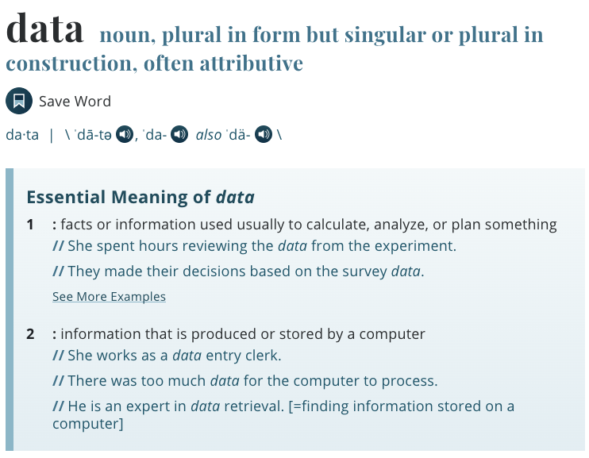
What is a Database?
Well, first, let’s take a step back: What is data?

Slide 11
What is a Database?
A modern database system is a complex software system whose task is to manage a large, complex collection of data.
Collection of interrelated data
Set of programs to access the data
An environment that is both convenient and efficient to use
Databases touch all aspects of our lives
Notes:
We are in a digital world. The place to store data is database.
All require databases
Almost everything in our life are related to digital data and databases. Databses are like Internet, are the basic infrastructure in modern society.

Slide 12



Applications of Database
Enterprise Information
Sales: customers, products, purchases
Accounting: payments, receipts, assets
Human Resources: Information about employees, salaries, payroll taxes.
Manufacturing
Management of production, inventory, orders, supply chain.
Universities
Registration, grades
Notes:
We are in a digital world. The place to store data is database.
All require databases
Almost everything in our life are related to digital data and databases. Databses are like Internet, are the basic infrastructure in modern society.

Slide 13
Applications of Database
Databases are everywhere today
… but the concept is old
The idea was to have one system doing once and for all the boring data storage/retrieval part
What boring parts?
Notes:
We are in a digital world. The place to store data is database.
All require databases
Almost everything in our life are related to digital data and databases. Databses are like Internet, are the basic infrastructure in modern society.

Slide 14


Purpose of Database Systems
In the early days ...
Database applications were built directly on top of file systems
(And we will have a lab session about it)
However, it suffers from many issues, including (but not limited to):
Data redundancy and inconsistency 数据冗余与不一致性
Data isolation 数据隔离
Integrity problems 完整性
Atomicity of operations 操作原子性
Concurrent access by multiple users 并发访问
Security problems 安全问题
Notes:
Data redundancy and inconsistency: data is stored in multiple file formats resulting induplication of information in different files
Difficulty in accessing data
Need to write a new program to carry out each new task
Data isolation
Multiple files and formats
Integrity problems
Integrity constraints (e.g., account balance > 0) become “buried” in program code rather than being stated explicitly
Hard to add new constraints or change existing ones
Atomicity of updates
Failures may leave database in an inconsistent state with partial updates carried out
Example: Transfer of funds from one account to another should either complete or not happen at all
Concurrent access by multiple users
Concurrent access needed for performance
Uncontrolled concurrent accesses can lead to inconsistencies
Ex: Two people reading a balance (say 100) and updating it by withdrawing money (say 50 each) at the same time
Security problems
Hard to provide user access to some, but not all, data

Slide 15
Let’s Show an Example
Write a Java program to manage information of all students in CS307
We have classroom sessions and lab sessions
(potential redundancy of students)
A new Java class method for each task
(difficulty in accessing data)
Maybe you will split the students into files based on lab session times
(split into multiple files; hard to manage the files)
You need to check the validity of Student IDs and classes
(hard to maintain integrity constraints)
Atomicity? Concurrency? Security? All need to be handled by yourself

Slide 16
Let’s Show an Example
(Well, still remember how to read and write files in Java?)
Write a Java program to manage information of all students in CS307
We have classroom sessions and lab sessions
(potential redundancy of students)
A new Java class method for each task
(difficulty in accessing data)
Maybe you will split the students into files based on lab session times
(split into multiple files; hard to manage the files)
You need to check the validity of Student IDs and classes
(hard to maintain integrity constraints)
Atomicity? Concurrency? Security? All need to be handled by yourself

Slide 17

Let’s Show an Example
What is more,
Can you reuse the code you just wrote in a staff management system?

Slide 18

Purpose of Database Systems
In the early days ...
Database applications were built directly on top of file systems
(And we will have a lab session about it)
However, it suffers from many issues, including (but not limited to):
Data redundancy and inconsistency 数据冗余与不一致性
Data isolation 数据隔离
Integrity problems 完整性
Atomicity of operations 操作原子性
Concurrent access by multiple users 并发访问
Security problems 安全问题
Database systems offer solutions to all the problems mentioned above
Database
Notes:
Data redundancy and inconsistency: data is stored in multiple file formats resulting induplication of information in different files
Difficulty in accessing data
Need to write a new program to carry out each new task
Data isolation
Multiple files and formats
Integrity problems
Integrity constraints (e.g., account balance > 0) become “buried” in program code rather than being stated explicitly
Hard to add new constraints or change existing ones
Atomicity of updates
Failures may leave database in an inconsistent state with partial updates carried out
Example: Transfer of funds from one account to another should either complete or not happen at all
Concurrent access by multiple users
Concurrent access needed for performance
Uncontrolled concurrent accesses can lead to inconsistencies
Ex: Two people reading a balance (say 100) and updating it by withdrawing money (say 50 each) at the same time
Security problems
Hard to provide user access to some, but not all, data

Slide 19
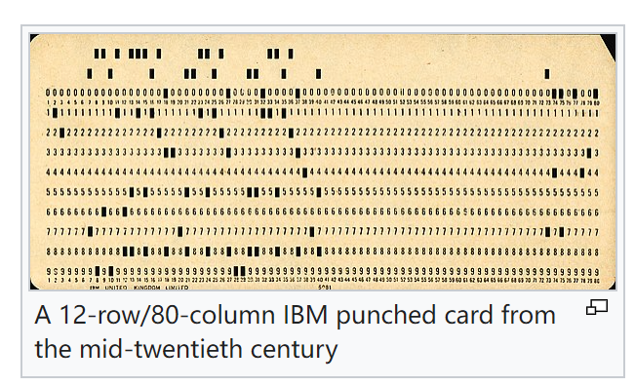
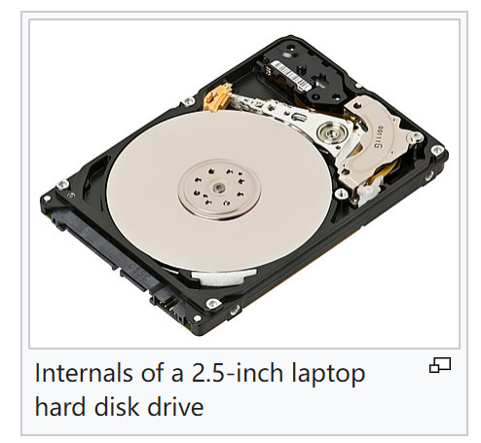
A Bit of History
1950s and early 1960s: 打孔卡
Data processing using magnetic tapes for storage
Tapes provided only sequential access
Punched cards for input
Late 1960s and 1970s: 硬盘
Hard disks allowed direct access to data
Network and hierarchical data models in widespread use
Ted Codd defines the relational data model
Would win the ACM Turing Award for this work
IBM Research begins System R prototype
UC Berkeley (Michael Stonebraker) begins Ingres prototype
Oracle releases first commercial relational database
High-performance (for the era) transaction processing

Slide 20
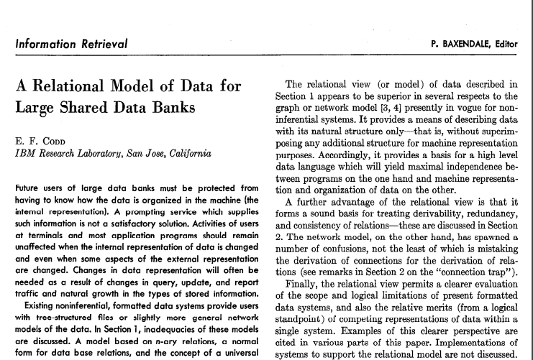

A Bit of History
Edgar F. “Ted” Codd
1923 – 2003
Turing Award 1981
E. F. Codd, A Relational Model of Data for Large Shared Data Banks,
Information Retrieval, June, 1970
Notes:
In the history of Database, there is an important paper. The title of the paper is “a relational model of data for large shared data banks”. The paper was by Edgar Codd. At that time, Codd worked in IBM. IBM was like Google, MS these kinds of companies at that time. We can say that it is this paper created the area of database. And Edgar Codd is the god father of this area.
考试前感觉考不过了，拜拜他

Slide 21
A Bit of History
1980s: SQL工业应用
Research relational prototypes evolve into commercial systems
SQL becomes industrial standard
Parallel and distributed database systems
Wisconsin, IBM, Teradata
Object-oriented database systems
1990s: 互联网
Large decision support and data-mining applications
Large multi-terabyte data warehouses
Emergence of Web commerce

Slide 22

A Bit of History
2000s: 非SQL大规模数据库
Big data storage systems
Google BigTable, Yahoo PNuts, Amazon,
“NoSQL” systems.
Big data analysis: beyond SQL
MapReduce
2010s: SQL重出江湖
SQL reloaded
SQL front end to MapReduce systems
Massively parallel database systems
Multi-core main-memory databases
MapReduce是一种编程模型，用于大规模数据集（大于1TB）的并行运算。
概念"Map（映射）"和"Reduce（归约）"，是它们的主要思想，都是从函数式编程语言里借来的，还有从矢量编程语言里借来的特性。

Slide 23
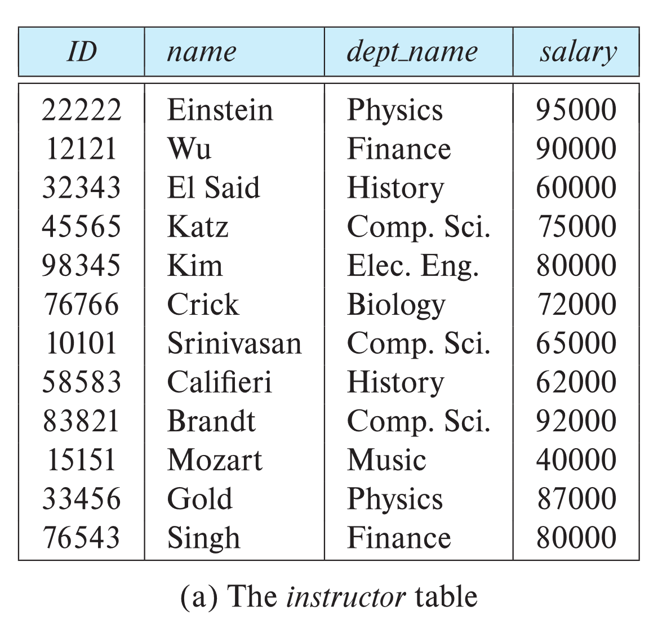
Relational Database
Columns (Attributes)
Based on the relational model of data
Organizes data into one or more tables
Rows are also called records or tuples
Columns are also called attributes
Rows
(Tuples)
Notes:
In this course, we will mainly focus on relational database. There are some other kinds of databases. I will introduce them at the end of the semester. But we mainly focus on relational databases.
Ralational databases are based on the relational model of data.
It organizes data into tables.
Rows in each table are also called records, or tuples.
Columns are all called attributes.

Slide 24

Relational Database
Each column stores a piece of data
One row represents a “known fact”:
“Audrey Hepburn was born on 1929/05/04 and looked like this.”
Surname | Firstname | Birthdate | Picture
Hepburn | Audrey | 4-May-1929
Notes:
In this course, we will mainly focus on relational database. There are some other kinds of databases. I will introduce them at the end of the semester. But we mainly focus on relational databases.
Ralational databases are based on the relational model of data.
It organizes data into tables.
Rows in each table are also called records, or tuples.
Columns are all called attributes.

Slide 25

Relational Database
Each column stores a piece of data
One row represents a “known fact”:
“Audrey Hepburn was born on 1929/05/04 and looked like this.”
All the pieces of data in a row are related, hence "relational".
Surname | Firstname | Birthdate | Picture
Hepburn | Audrey | 4-May-1929
Notes:
In this course, we will mainly focus on relational database. There are some other kinds of databases. I will introduce them at the end of the semester. But we mainly focus on relational databases.
Ralational databases are based on the relational model of data.
It organizes data into tables.
Rows in each table are also called records, or tuples.
Columns are all called attributes.

Slide 26
Relational Database
关系代数是一种抽象的查询语言，用对关系的运算来表达查询，作为研究关系数据语言的数学工具。关系代数的运算对象是关系，运算结果亦为关系。
But Codd’s “big idea”
You could operate on the relations and get new sets
Relational Algebra
Theoretical foundation for relational databases
select
project
join

Slide 27
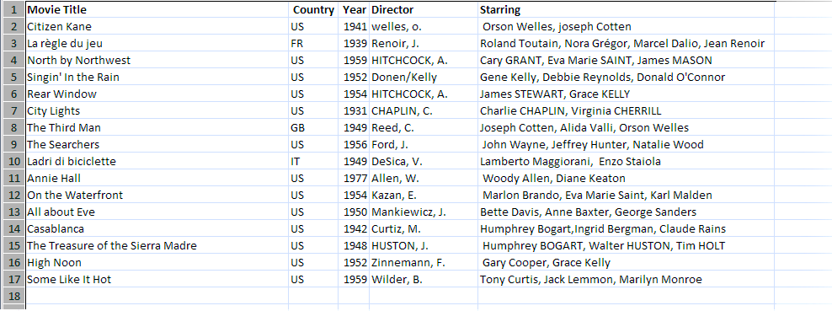
Key
Example: A Film Database
Easy to find such as “The 100 greatest films ever”
Sometimes as a .csv file that you can load into a spreadsheet

Slide 28
Key
Duplicates are forbidden in relational tables
Introduces potential errors such as when counting the number of movies
Movie Title | Country | Year | Director | Starring
Citizen Kane | US | 1941 | welles, o. | Orson Welles, Joseph Cotten
La règle du jeu | FR | 1939 | Renoir, J. | Roland Toutain, Nora Grégor, Marcel Dalio, Jean Renoir
North By Northwest | US | 1959 | HITCHCOCK, A. | Cary Grant, Eva Marie Saint, James Mason
Singin' in the Rain | US | 1952 | Donen/Kelly | Gene Kelly, Debbie Reynolds, Donald O'Connor
Rear Window | US | 1954 | HITCHCOCK, A. | James Stewart, Grace Kelly
North By Northwest | US | 1959 | HITCHCOCK, A. | Cary Grant, Eva Marie Saint, James Mason
Notes:
Let’s go back to the film information. What’s the key with films. The tile looks correct, it is the obvious answer.

Slide 29
Key
How to identify “different rows” in a table?
A column (or a set of columns) to differentiate one row from another
In the film data … How about the movie titles?
Movie Title | Country | Year | Director | Starring
Citizen Kane | US | 1941 | welles, o. | Orson Welles, Joseph Cotten
La règle du jeu | FR | 1939 | Renoir, J. | Roland Toutain, Nora Grégor, Marcel Dalio, Jean Renoir
North By Northwest | US | 1959 | HITCHCOCK, A. | Cary Grant, Eva Marie Saint, James Mason
Singin' in the Rain | US | 1952 | Donen/Kelly | Gene Kelly, Debbie Reynolds, Donald O'Connor
Rear Window | US | 1954 | HITCHCOCK, A. | James Stewart, Grace Kelly
Notes:
But if you have no duplicates, you need to identify what allows you to differentiate one row from another. It may be one column, or one set of columns, known collectively as a "key".

Slide 30
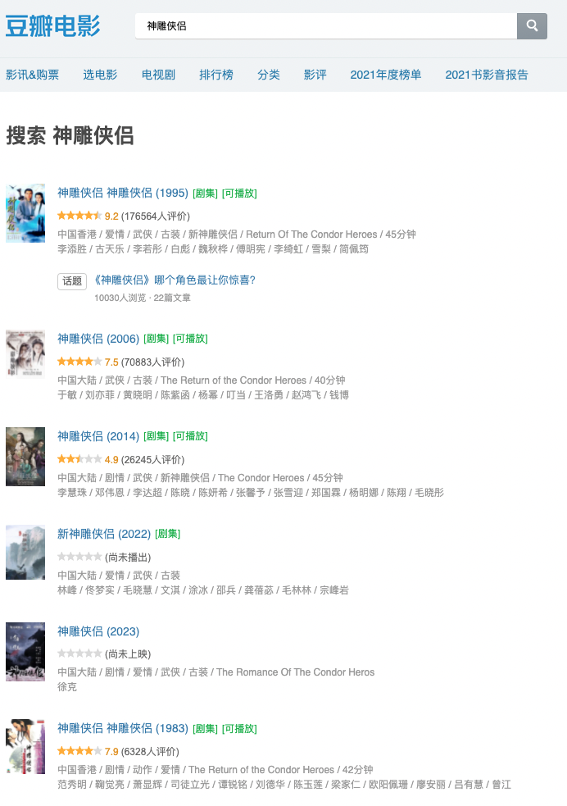
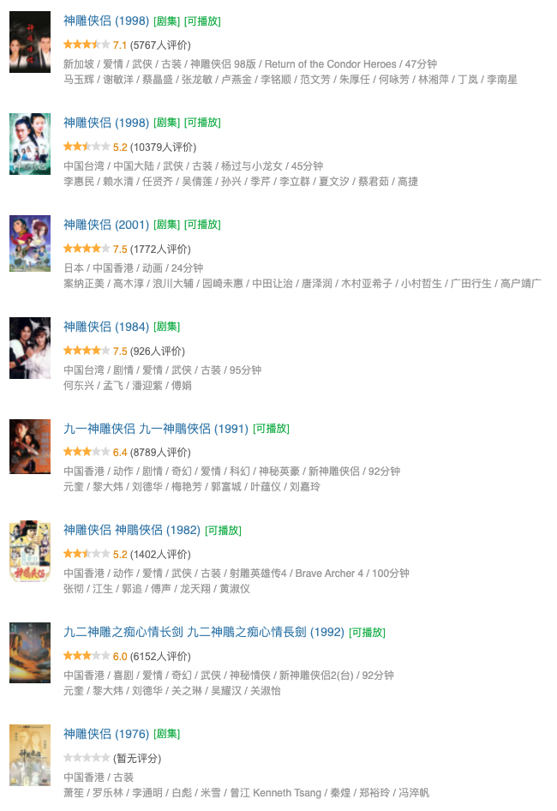
Notes:
BUT, we have some films that their names are the same! Such as there are many items called 神雕侠侣
So the title cannot be the key!

Slide 31
Key
How to identify “different rows” in a table?
A column (or a set of columns) to differentiate one row from another
In the film data … How about the movie titles? Title + Director?
Movie Title | Country | Year | Director | Starring
Citizen Kane | US | 1941 | welles, o. | Orson Welles, Joseph Cotten
La règle du jeu | FR | 1939 | Renoir, J. | Roland Toutain, Nora Grégor, Marcel Dalio, Jean Renoir
North By Northwest | US | 1959 | HITCHCOCK, A. | Cary Grant, Eva Marie Saint, James Mason
Singin' in the Rain | US | 1952 | Donen/Kelly | Gene Kelly, Debbie Reynolds, Donald O'Connor
Rear Window | US | 1954 | HITCHCOCK, A. | James Stewart, Grace Kelly
Notes:
But if you have no duplicates, you need to identify what allows you to differentiate one row from another. It may be one column, or one set of columns, known collectively as a "key".

Slide 32




But, Hitchcock did It (So it was with the COD game)
Same developer (Infinite Ward)
Same publisher (Activision)
Two different years (2007, 2019)

Slide 33
Key
How to identify “different rows” in a table?
A column (or a set of columns) to differentiate one row from another
In the film data … How about the movie titles? Title + Director?
Title + Director + Year?
Movie Title | Country | Year | Director | Starring
Citizen Kane | US | 1941 | welles, o. | Orson Welles, Joseph Cotten
La règle du jeu | FR | 1939 | Renoir, J. | Roland Toutain, Nora Grégor, Marcel Dalio, Jean Renoir
North By Northwest | US | 1959 | HITCHCOCK, A. | Cary Grant, Eva Marie Saint, James Mason
Singin' in the Rain | US | 1952 | Donen/Kelly | Gene Kelly, Debbie Reynolds, Donald O'Connor
Rear Window | US | 1954 | HITCHCOCK, A. | James Stewart, Grace Kelly
Notes:
But if you have no duplicates, you need to identify what allows you to differentiate one row from another. It may be one column, or one set of columns, known collectively as a "key".

Slide 34

Key
Ok, you have made it this time, but –
The combination is too difficult for either remembering or computing
Need to compare multiple times on different columns
Think about deduplication
What if there are multiple items in a single column?
For example, more than one directors in a movie?
Notes:
But there is another problem. Some films have several directors!
Such as for film:我和我的祖国. There are 6 directors. How to describe the two directors in the attribute Director? It is a problem.

Slide 35
Primary Key
Additional material about creating a unique ID for each row: https://en.wikipedia.org/wiki/Universally_unique_identifier
Some of the keys may be unique for every row
Student ID, Email address, 18-digit ID number, etc.
Usually, it is a good practice to choose the simplest one
(Or, create one)
Movie ID | Movie Title | Country | Year | Director | Starring
0 | Citizen Kane | US | 1941 | welles, o. | Orson Welles, Joseph Cotten
1 | La règle du jeu | FR | 1939 | Renoir, J. | Roland Toutain, Nora Grégor, Marcel Dalio, Jean Renoir
2 | North By Northwest | US | 1959 | HITCHCOCK, A. | Cary Grant, Eva Marie Saint, James Mason
3 | Singin' in the Rain | US | 1952 | Donen/Kelly | Gene Kelly, Debbie Reynolds, Donald O'Connor
4 | Rear Window | US | 1954 | HITCHCOCK, A. | James Stewart, Grace Kelly
Notes:
If there are several attributes can be a key. You can choose one of them as the primary key. Normally you should choose the simplest one to be the primary kay.

Slide 36
Normalization
A way of standardizing your data
Movie ID | Movie Title | Country | Year | Director | Starring
0 | Citizen Kane | US | 1941 | welles, o. | Orson Welles, Joseph Cotten
1 | La règle du jeu | FR | 1939 | Renoir, J. | Roland Toutain, Nora Grégor, Marcel Dalio, Jean Renoir
2 | North By Northwest | US | 1959 | HITCHCOCK, A. | Cary Grant, Eva Marie Saint, James Mason
3 | Singin' in the Rain | US | 1952 | Donen/Kelly | Gene Kelly, Debbie Reynolds, Donald O'Connor
4 | Rear Window | US | 1954 | Alfred Hitchcock | James Stewart, Grace Kelly
*Too many different ways of spelling*
Notes:
One common problem with databases is that data may be entered at different time by different people. If you let them enter data the way they want, it will make data retrieval very difficult because when they search, computers merely compare bytes. You need to standardize your data, a process also known as normalization.

Slide 37
Normalization
“First Norm Rule” (1NF)
Each column should only contain ONE piece of information
Director | Starring
welles, o. | Orson Welles, Joseph Cotten
Renoir, J. | Roland Toutain, Nora Grégor, Marcel Dalio, Jean Renoir
HITCHCOCK, A. | Cary Grant, Eva Marie Saint, James Mason
Donen/Kelly | Gene Kelly, Debbie Reynolds, Donald O'Connor
HITCHCOCK, A. | James Stewart, Grace Kelly
Director_Firstname | Director_Lastname
Alfred | Hitchcock
Orson | Welles
Starring_Firstname | Starring_Lastname
Orson | Welles
Joseph | Cotten
Notes:
To standardize the person name. we should follow the first rule of normalization. It is also know as First Normal Form.
Codd defined several normal forms for normalization. This is the first form.
First Normal form is to make sure each column should only contains one piece of information. So surnames and first names should be stored in different columns.
Besides of this, we should also follow some kind of standard capitalization. We can convert the first letters to capital letters. we can also convert all letters to capital letters, or all lower-case letters.
Whatever which standard you choose for the letters, you should respect the standard.

Slide 38
Normalization
“First Norm Rule” (1NF)
Each column should only contain ONE piece of information
Director | Starring
welles, o. | Orson Welles, Joseph Cotten
Renoir, J. | Roland Toutain, Nora Grégor, Marcel Dalio, Jean Renoir
HITCHCOCK, A. | Cary Grant, Eva Marie Saint, James Mason
Donen/Kelly | Gene Kelly, Debbie Reynolds, Donald O'Connor
HITCHCOCK, A. | James Stewart, Grace Kelly
Director_Firstname | Director_Lastname | Born | Died
Alfred | Hitchcock | 1899 | 1980
Orson | Welles | 1915 | 1985
*Extend the table to represent all directors*
Notes:
To standardize the person name. we should follow the first rule of normalization. It is also know as First Normal Form.
Codd defined several normal forms for normalization. This is the first form.
First Normal form is to make sure each column should only contains one piece of information. So surnames and first names should be stored in different columns.
Besides of this, we should also follow some kind of standard capitalization. We can convert the first letters to capital letters. we can also convert all letters to capital letters, or all lower-case letters.
Whatever which standard you choose for the letters, you should respect the standard.

Slide 39
Normalization
“First Norm Rule” (1NF)
Each column should only contain ONE piece of information
Movie ID | Movie Title | Country | Year | Director ID | Starring
0 | Citizen Kane | US | 1941 | 2 | Orson Welles, Joseph Cotten
1 | La règle du jeu | FR | 1939 | 5 | Roland Toutain, Nora Grégor, Marcel Dalio, Jean Renoir
2 | North By Northwest | US | 1959 | 1 | Cary Grant, Eva Marie Saint, James Mason
3 | Singin' in the Rain | US | 1952 | 6 | Gene Kelly, Debbie Reynolds, Donald O'Connor
4 | Rear Window | US | 1954 | 1 | James Stewart, Grace Kelly
Director ID | Director_Firstname | Director_Lastname | Born | Died
1 | Alfred | Hitchcock | 1899 | 1980
2 | Orson | Welles | 1915 | 1985
3 | …. | … | … | …
Link the director information between tables
Notes:
The director name in table Movies can be replace with the directorID.
In the table, we can find that the first 3 films were directed by Director 1. Who is director 1? We can find in Table directors. Director 1 is Hitchcock. We can also find that he was born in 1899 and died in 1980.

Slide 40
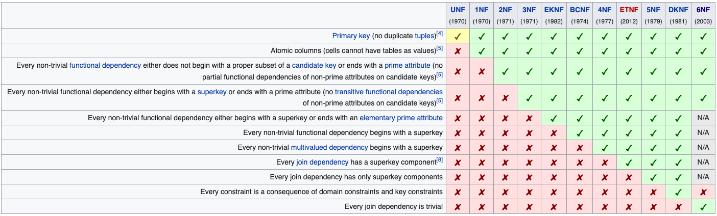
Normalization
Normal Form (NF)
1NF: Simple attributes
2NF: Attributes depend on the full key
3NF: Non-key attributes do not depend on each other
And many others
https://en.wikipedia.org/wiki/Database_normalization

Slide 41

Normalization
Every non key attribute must provide a fact about the key,
the whole key,
and nothing but the key.
William Kent (1936 – 2005)
William Kent. "A Simple Guide to Five Normal Forms in Relational Database Theory", Communications of the ACM 26 (2), Feb. 1983, pp. 120–125.

Slide 42
Normalization
Question:
What if there are multiple director?
“First Norm Rule” (1NF)
Each column should only contain ONE piece of information
Movie ID | Movie Title | Country | Year | Director ID | Starring
0 | Citizen Kane | US | 1941 | 2 | Orson Welles, Joseph Cotten
1 | La règle du jeu | FR | 1939 | 5 | Roland Toutain, Nora Grégor, Marcel Dalio, Jean Renoir
2 | North By Northwest | US | 1959 | 1 | Cary Grant, Eva Marie Saint, James Mason
3 | Singin' in the Rain | US | 1952 | 6 | Gene Kelly, Debbie Reynolds, Donald O'Connor
4 | Rear Window | US | 1954 | 1 | James Stewart, Grace Kelly
Director ID | Director_Firstname | Director_Lastname | Born | Died
1 | Alfred | Hitchcock | 1899 | 1980
2 | Orson | Welles | 1915 | 1985
3 | …. | … | … | …
Link the director information between tables
Notes:
The director name in table Movies can be replace with the directorID.
In the table, we can find that the first 3 films were directed by Director 1. Who is director 1? We can find in Table directors. Director 1 is Hitchcock. We can also find that he was born in 1899 and died in 1980.

Slide 43
Entity and Relationship
A bad idea: Add more columns in the Movie table
Waste of space (not too many movies have 3 directors, let alone 6)
Movie ID | Movie Title | Country | Year | Director ID | Director 2 ID | Director 3 ID | Starring

Slide 44
Entity and Relationship
A bad idea: Add more columns in the Movie table
Waste of space (not too many movies have 3 directors, let alone 6)
How about starring? 10+ more columns?
Movie ID | Movie Title | Country | Year | Director ID | Director 2 ID | Director 3 ID | Starring

Slide 45
Entity and Relationship
Further refactoring of the tables …
Movie ID | Movie Title | Country | Year
0 | Citizen Kane | US | 1941
1 | La règle du jeu | FR | 1939
2 | North By Northwest | US | 1959
3 | Singin' in the Rain | US | 1952
4 | Rear Window | US | 1954
Director ID | Director_Firstname | Director_Lastname | Born | Died
1 | Alfred | Hitchcock | 1899 | 1980
2 | Orson | Welles | 1915 | 1985
3 | …. | … | … | …
Relationship?
Director Entities
Movie Entities
Notes:
We must find a solution for that.
First of all, let us remove the director and actor information form the table. Then the table only contains movieID, movie title, country code, and the year of release

Slide 46
Entity and Relationship
Further refactoring of the tables …
Movie ID | Movie Title | Country | Year
0 | Citizen Kane | US | 1941
1 | La règle du jeu | FR | 1939
2 | North By Northwest | US | 1959
3 | Singin' in the Rain | US | 1952
4 | Rear Window | US | 1954
Directed By
Director ID | Director_Firstname | Director_Lastname | Born | Died
1 | Alfred | Hitchcock | 1899 | 1980
2 | Orson | Welles | 1915 | 1985
3 | …. | … | … | …
Movie ID | Director ID
0 | 2
1 | 5
2 | 1
Director Entities
Relationship!
Movie Entities
Notes:
The proper way to solve such a problem is to create an additional table that associates ONE director with ONE film, with as many rows per director as he has directed films, and as many rows per film as there are directors.

Slide 47
Entity and Relationship
Further refactoring of the tables … 把“列”转成“行” （矩阵相乘？）
Movie ID | Movie Title | Country | Year
0 | Citizen Kane | US | 1941
1 | La règle du jeu | FR | 1939
2 | North By Northwest | US | 1959
3 | Singin' in the Rain | US | 1952
4 | Rear Window | US | 1954
Directed By
Director ID | Director_Firstname | Director_Lastname | Born | Died
1 | Alfred | Hitchcock | 1899 | 1980
2 | Orson | Welles | 1915 | 1985
3 | …. | … | … | …
Movie ID | Director ID
0 | 2
1 | 5
2 | 1
… | …
16 | 8
16 | 9
16 | 10
Director Entities
Question:
What if there are multiple directors?
Answer:
Multiple rows in the relationship!
Movie Entities
Notes:
We must find a solution for that.
In the table, one director is associate with one film. If the director directed many films, there will be more rows in the table for the director. If a film has two directors, there are also two rows for the film with different directors.

Slide 48
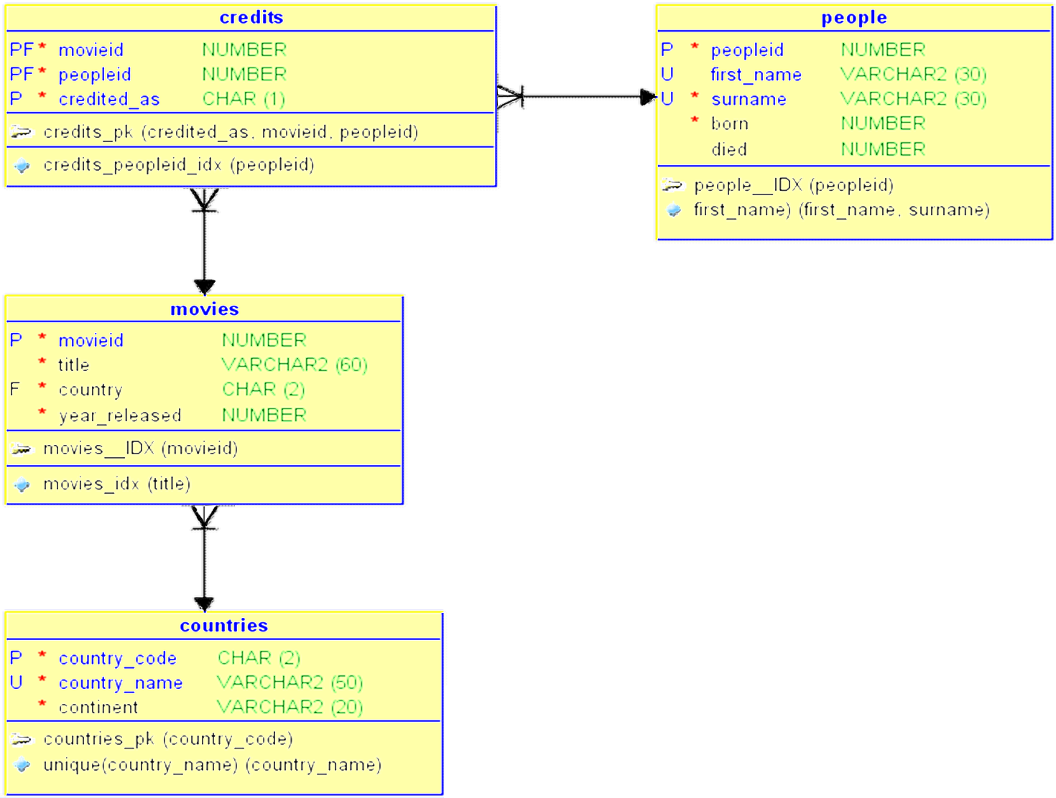
Entity and Relationship
Starring -> Actor table
Country -> Country and Region table
You can also link the movies with corresponding actors, countries/regions, etc.
Entity Relationship Diagram (E/R Diagram, ER Diagram, ERD)
A way of representing entity tables and their relationships (relationship tables)

Slide 49
Outline
Introduction

Slide 50
Outline
Basic SQL
Create tables and insert data
Basic Queries
Update data
Introduction

Slide 51
Outline
Basic SQL
Create tables and insert data
Basic Queries
Update data
Database Design
NFs
ER Diagram
Relational DB Design
Introduction

Slide 52

Outline
Basic SQL
Create tables and insert data
Basic Queries
Update data
Database Design
NFs
ER Diagram
Relational DB Design
Introduction
Practical
Modules
Intermediate SQL
Window Functions
Views
Transactions
Advanced SQL
Functions
Procedures
Triggers
Performance
Lab
Practices

Slide 53
Outline
Theoretical
Modules
Big Data Analytics
Big Data Storage, Querying, and Processing
OLAP, Data Mining, Visualization
Storage Management
Storage Structure
Indexing
Application Design
Access databases in programming
Complex Data Types (JSON, XML)
Basic SQL
Create tables and insert data
Basic Queries
Update data
Database Design
NFs
ER Diagram
Relational DB Design
Introduction
Relational Algebra
Practical
Modules
Intermediate SQL
Window Functions
Views
Transactions
Advanced SQL
Functions
Procedures
Triggers
Performance
Lab
Practices

Slide 54
Outline
What we may NOT (fully) cover
Programming Language Support
We will focus on one or two languages
Parallel and Distributed Databases 分布式数据库
Object-based Databases 面向对象
Blockchain 区块链
Advanced Relational Algebra and Calculus 高级关系代数与微积分
Advanced Data Mining and Analytics 高级数据挖掘与分析
… （以及一些其他你也许听过的“新技术”）

Slide 55
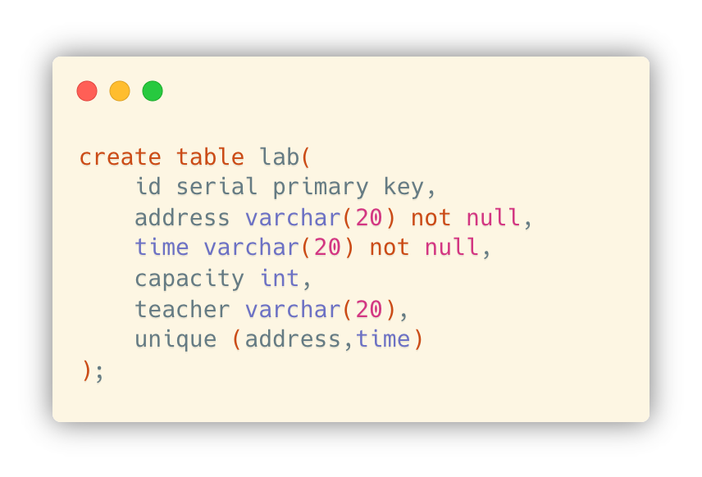
Data Definition and Manipulation
Data Definition Language (DDL)
DDL compiler generates a set of table templates stored in a data dictionary
Database schema
Integrity constraints (primary key, etc.)
Authorization (who can access it)

Slide 56
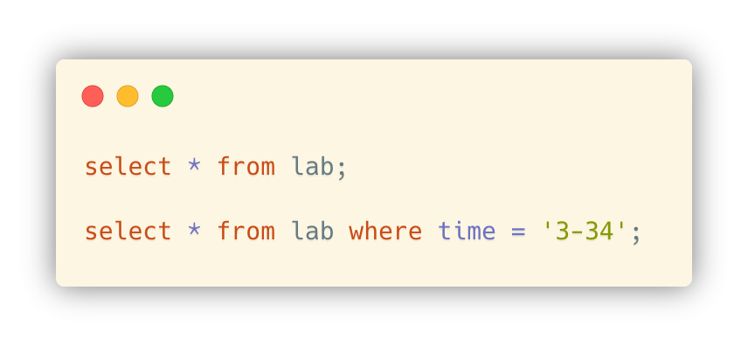
Data Definition and Manipulation
Data Manipulation Language (DML)
Language for accessing and updating the data organized by the appropriate data model (also known as query language)
SQL query language
Takes several tables as input (possibly only one) and always returns a single table

Slide 57
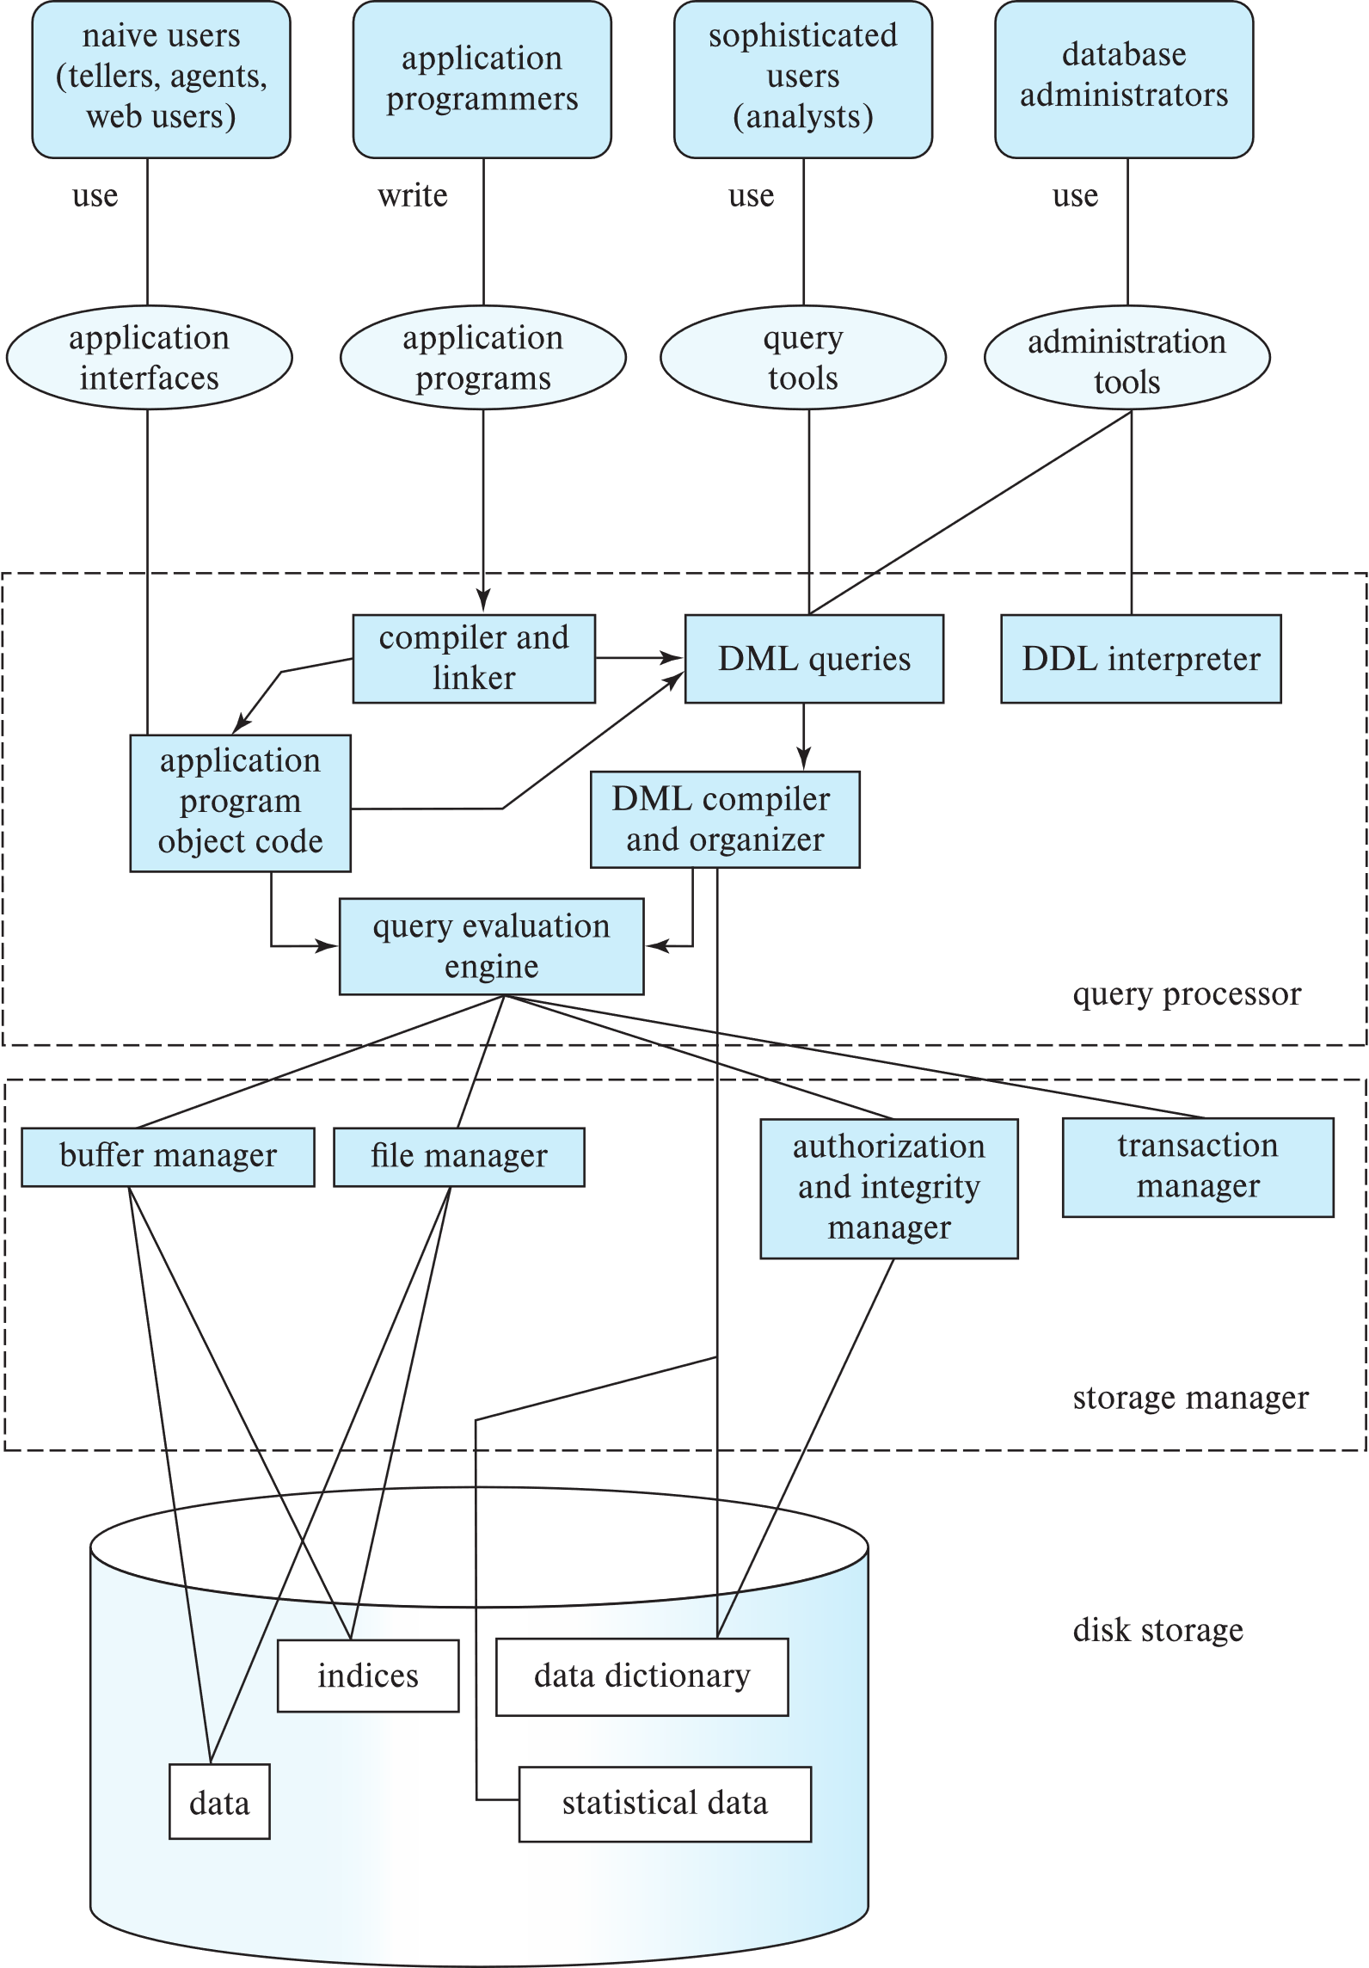
Database Users

Slide 58
Database Architecture
Notes:
There is a sentence summarized the 2nd and 3rd normal form.
…
The sentence was by William Kent, who was a scientist in IBM in the past.

Slide 59
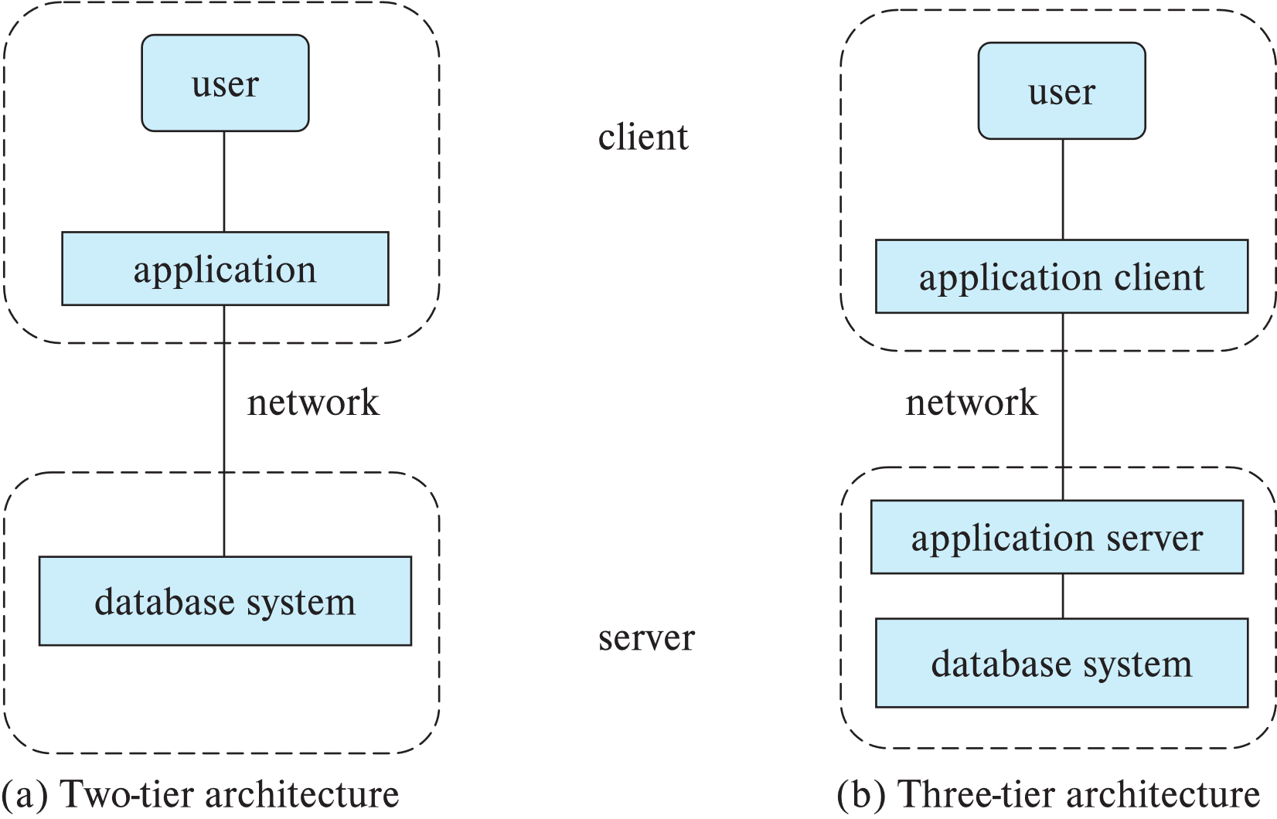
Database Applications
Database applications are usually partitioned into two or three parts
Application programs generally access databases through one of
Language extensions to allow embedded SQL
Application Program Interface (e.g., ODBC/JDBC) which allow SQL queries to be sent to a database

Slide 60
Thank you
QQ Group: 949474976

